Slide 1
Crop Production in India
PROJECT Submitted by: Naresh dhunde & Harsha Dhunde

Slide 2
Objective:
The scope of this project is to mainly proposing a business problem and finding the possible solution. So, here is the proposal for which I’ve worked for the entire project- ‘To provide the necessary information visualization, I'll analyze the crop production datas of India in different region and map them using Geocoder and Folium library.’
Benefits:
The Agriculture business domain, as a vital part of the overall supply chain, is expected
to highly evolve in the upcoming years via the developments, which are taking place on
the side of the Future Internet.

Slide 3
Abstract.
1. Introduction
1. What is Architecture Design Document?
2.Scope
2. General Descriptions
1. Product Perspective & Problem Statement
2. Tools used
3.Pre-processing
4.Methodology
5. Conclusion

Slide 4
What is Architecture design document? Any software needs the architectural design to represents the design of software. IEEE defines architectural design as “the process of defining a collection of hardware and software components and their interfaces to establish the framework for the development of a computer system.” The software that is built for computer-based systems can exhibit one of these many architectures. Each style will describe a system category that consists of : • A set of components (eg: a database, computational modules) that will perform a function required by the system. • The set of connectors will help in coordination, communication, and cooperation between the components. • Conditions that how components can be integrated to form the system. • Semantic models that help the designer to understand the overall properties of the system. 1.2 Scope Architecture Design Document (ADD) is an architecture design process that follows a step-b
Introduction

Slide 5
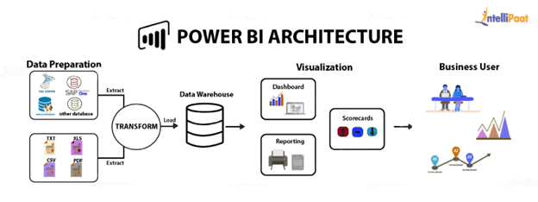
Architecture

Slide 6
1.Database Creation and connection - Create a database with name passed. If the database is already created, open the connection to the database. Table creation in the database. Insertion of files in the table 2.Make the Snowflake connection and set up the data source 3.Step 1: Configuring Power BI
1. Data Insertion into Database

Slide 7
Data sourcing/integration
The Power BI Service has its own inbuilt data connectors which allows easier connectivity to many common data source types, such as Snowflake, Oracle, My SQL & Flat files, CSV, Excel and XML. There are other various connectors to source data from online websites, news feeds, SaaS services and social media.

Slide 8
Data transformation :
The Inbuilt Power Query engine in Power BI Desktop provides a lot of transformation capabilities, such as:
removing duplicates
removing or renaming columns
replacing values with something else
building relationships
creating user defined hierarchies
Ideally, underlying source data will be coming from a data warehouse or other structured data source helping to minimize the effort required to transform data.

Slide 9
Prediction:
Maximum growth in production was in between year 2007-2008
Maximum downfall of growth was in year 1997-1998
Production of North Zone is decreased and West Zone, Union Territory production increased
Production In Whole Year Season declined continuously after the year 2003 but production In Rabi and Kharif Season increased after year 2003
production decresed in 2010-2011 in rabi and kharif season by production incresed in whole year

Slide 10
Q & A:
Q1) What’s the source of data?
The data for training is provided by the client in multiple batches and each batch contain multiple files
Q 2) What was the type of data?
The data was the combination of numerical and Categorical values.
Q 3) What’s the complete flow you followed in this Project?
Refer slide 5th for better Understanding

Slide 11
Q 6) What techniques were you using for data pre-processing?
The Inbuilt Power Query engine in Power BI Desktop provides a lot of transformation capabilities, such as:
removing duplicates
removing or renaming columns
replacing values with something else
building relationships
creating user defined hierarchies
Ideally, underlying source data will be coming from a data warehouse or other structured data source helping to minimize the effort required to transform data.

Slide 12
CONCLUSION
We used two different datasets for our visualization one with coconut values and another dataset for which we removed coconut values from there.
After this we used these datasets in Power BI and found different valuable insights from it which helped us to understand the variation in crop production of India based on different seasons, years, states and districts.

